Slide 1

Meethi Katha - Mockups
Crisis Starlet
WiT Hackathon – IBM - 2020

Slide 2
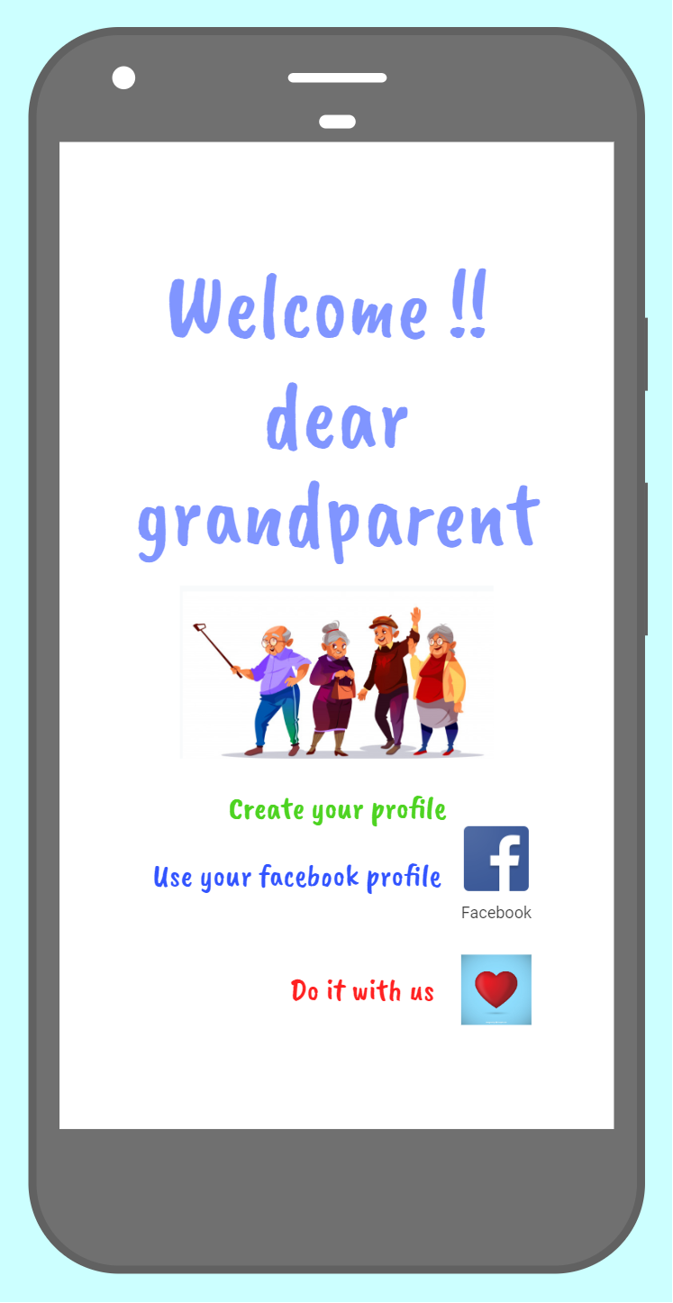
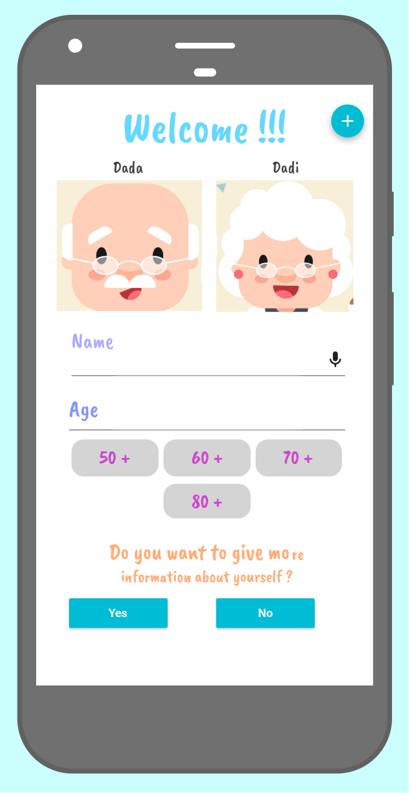
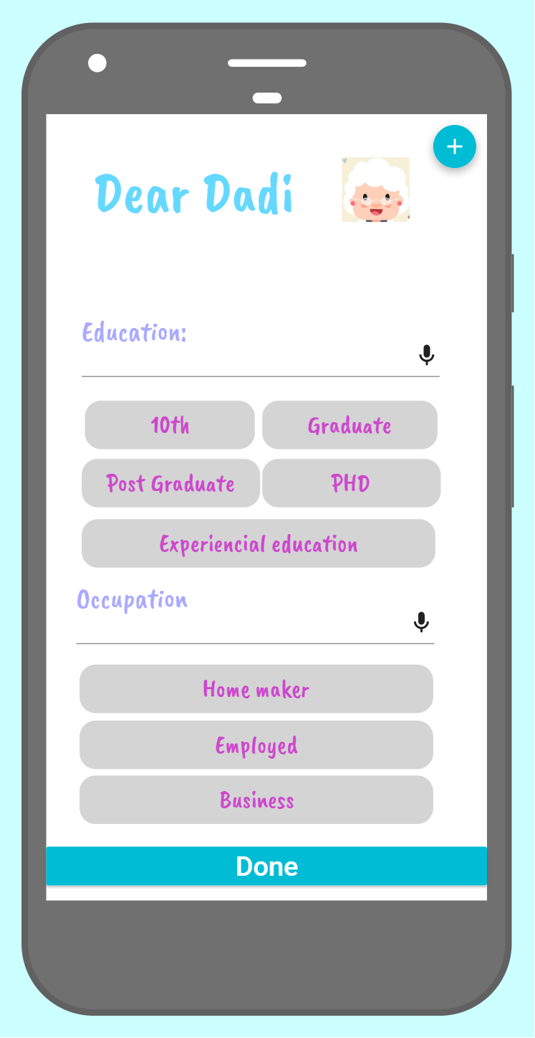

Grandparent Profile Creation Mockup
Profile creation page for grandparent
Simple 3 step profile creation
Additional information, if they want to give
Profile created !!

Slide 3
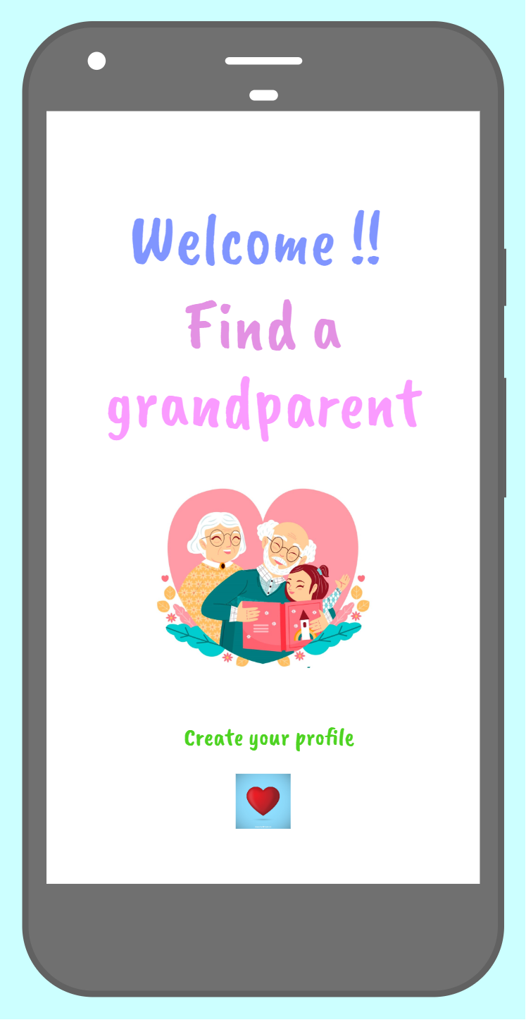
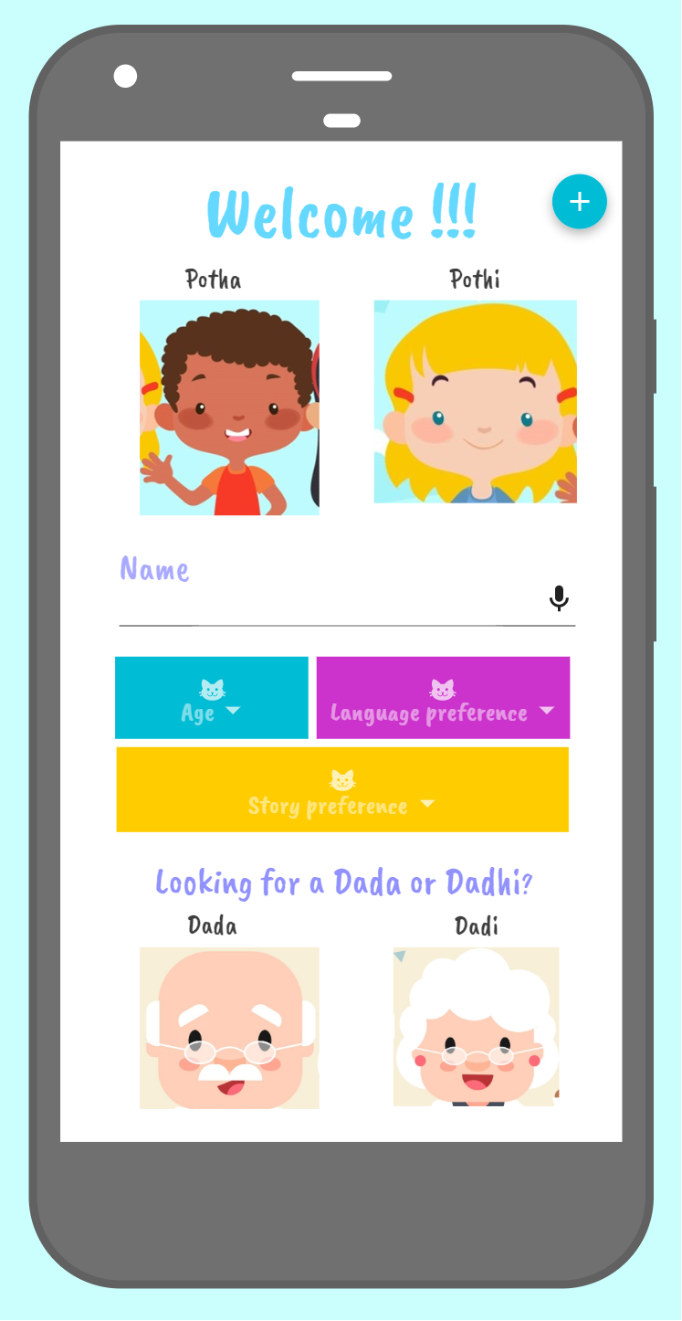
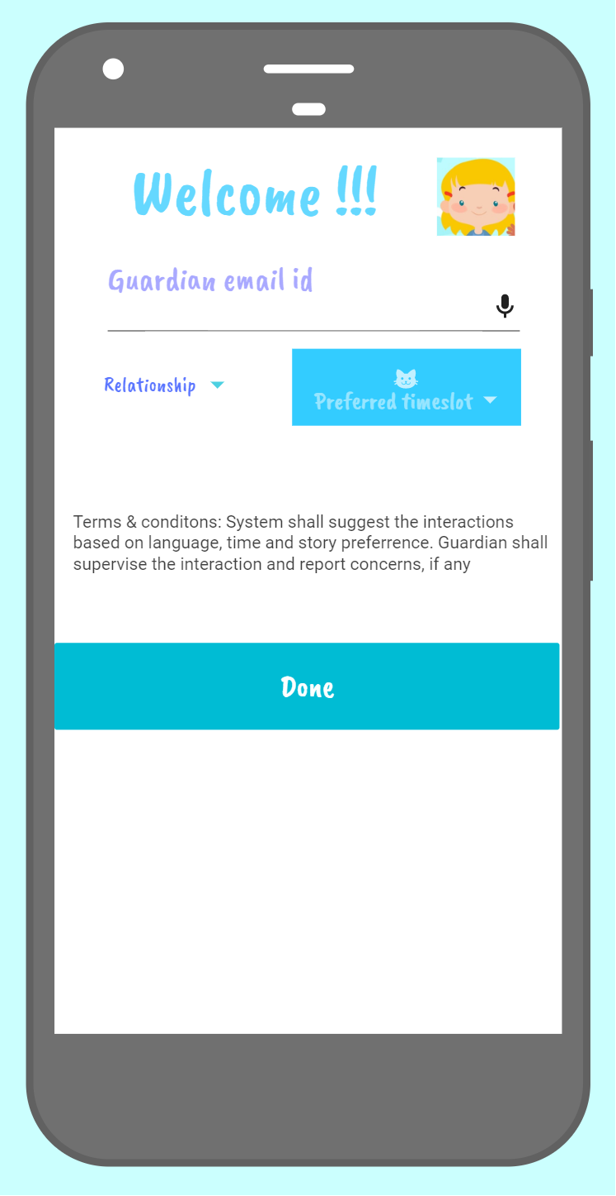
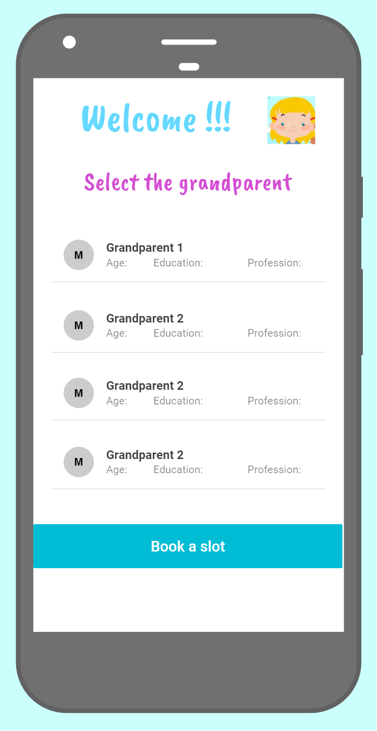
Grandchild Profile Creation Mockup
Based on selection, timeslots are provided for booking a slot.
Book a slot and have the interaction !!
Create profile by selection of language, story and grandparent preference
Collect Guardian details for the child
Based on language, timeslot, story and grandparent preference, options are suggested

Slide 4
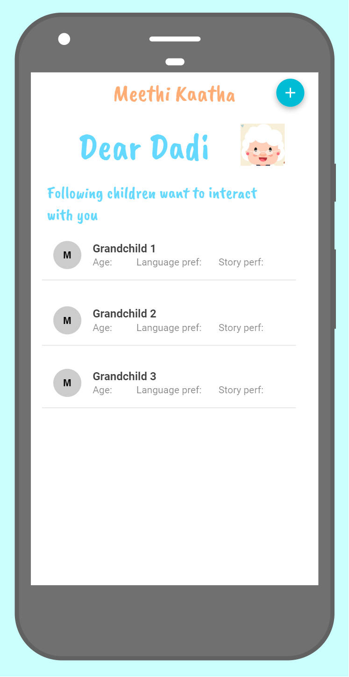
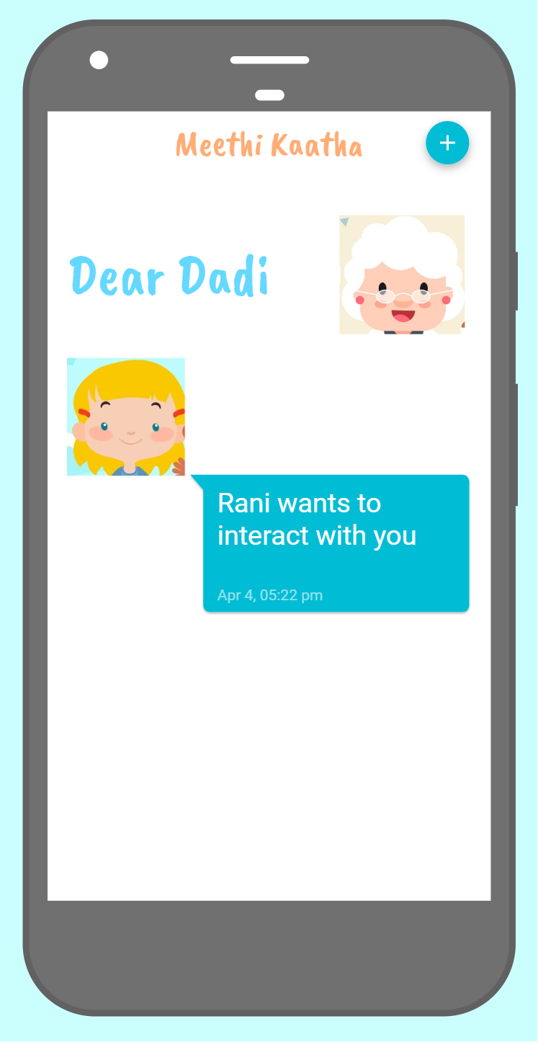
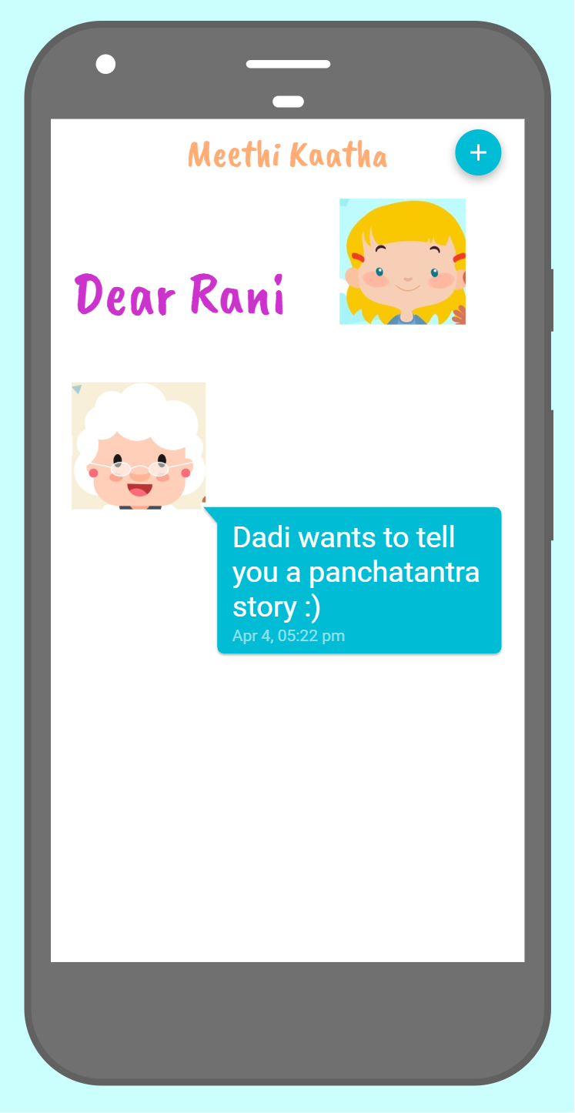
Making the connection between Grandparent & Child
Grandparent has to accept the request to interact
Time to meet ☺

Slide 5
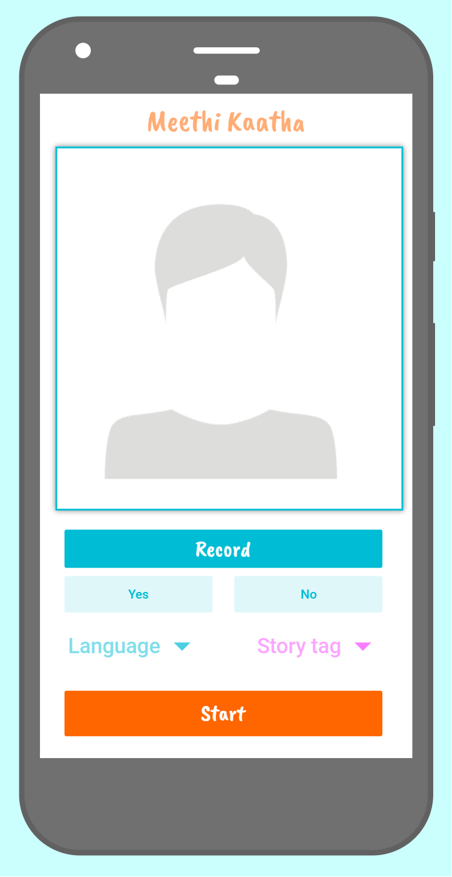

Starting the call (Grandparent view):
Choice of recording the interaction with grandparent. If recorded, would show in the profile and library
Each grandparent will be sent a welcome email, with links to videos on ‘how to use the application’, ‘ other grandparent experiences’ + a hands on training workflow (if required to be supported through – voice call)
Wireframe to help the grandparent align to the screen
Story tagging based on Morale, Character, Lesson
To auto-populate based on preference. Option to update
Start recorded session – Simple 3 step process

Slide 6
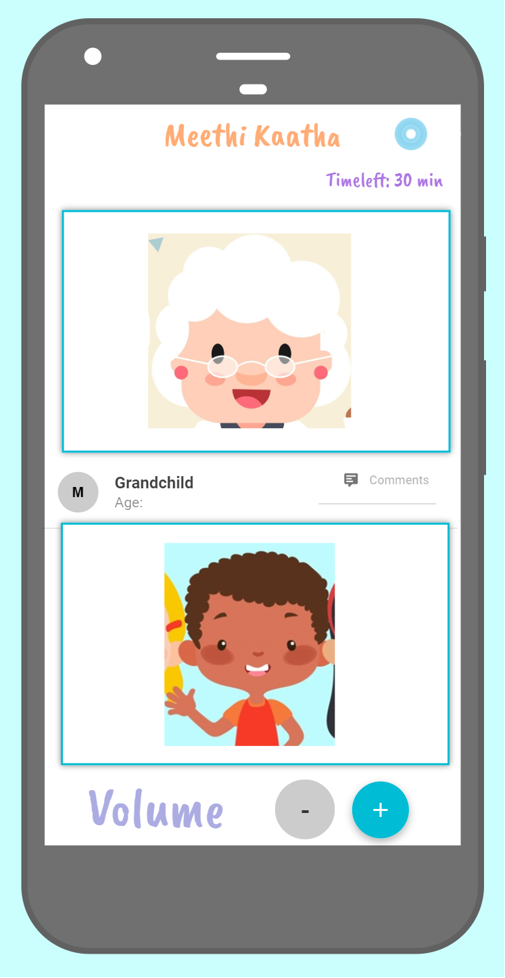
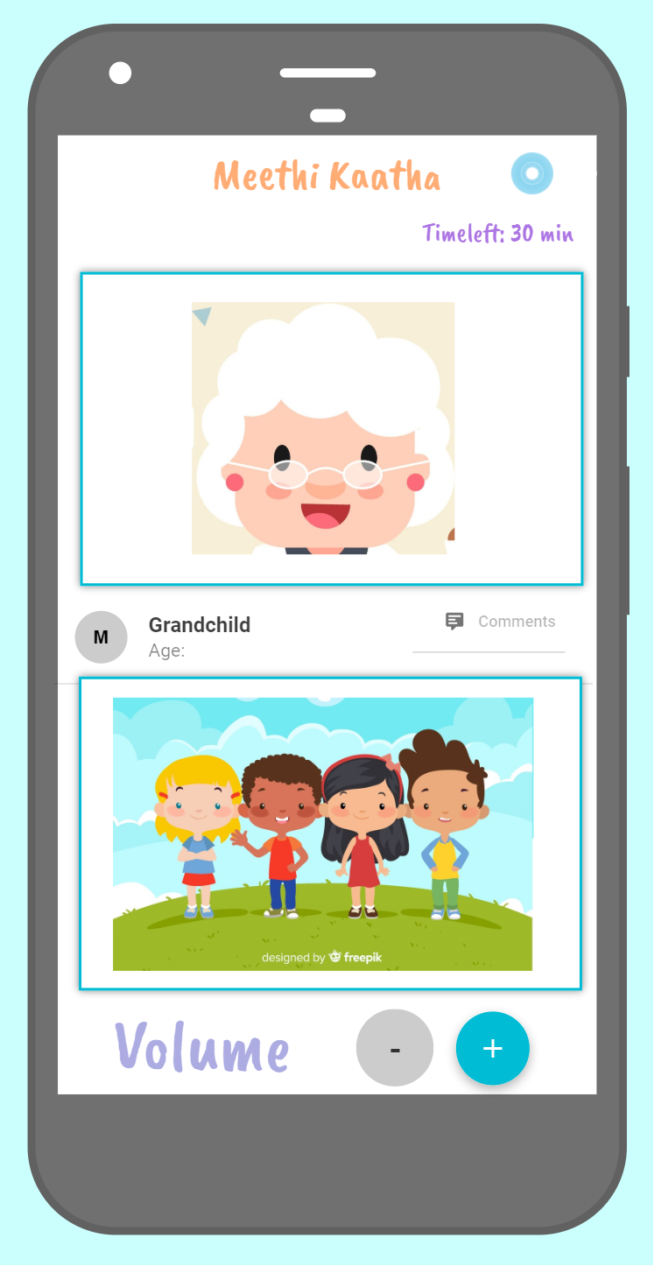
Interaction call (Grandparent view):
One to one interaction
One to many interaction
Indication of session being recorded
Clear indication of time left. With sound notification, with 10 mins and 5 mins is left. Option to extend calls shall be given
Option for Grandparent to give feedback on the kid. Not visible to the child. To be communicated to guardian

Slide 7
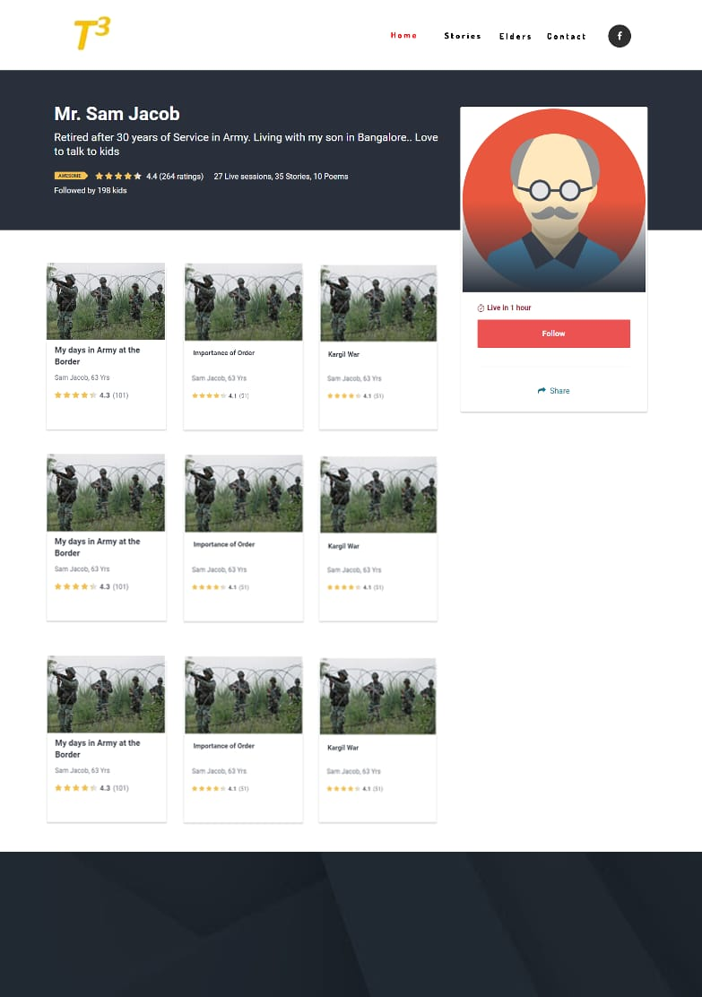
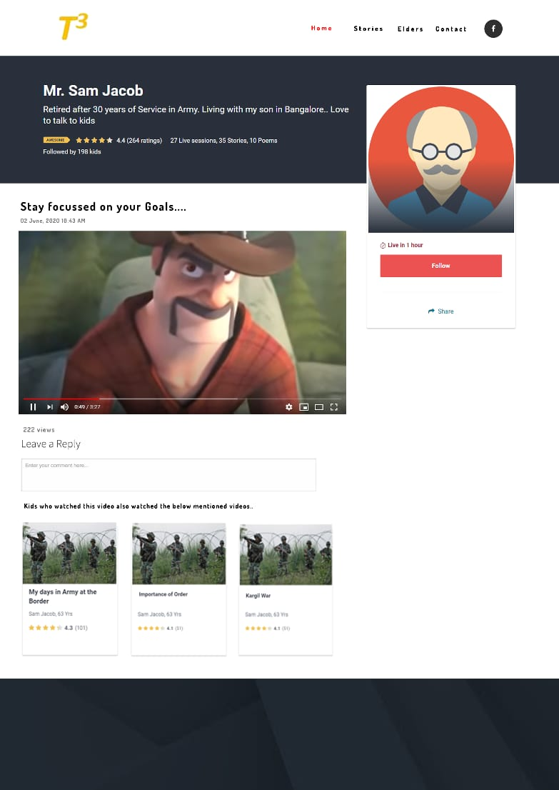
Dada Profile Mockup
Recorded interaction mockup
Meethi Katha
Meethi Katha

